Slide 1
THE CONNECTION BETWEEN THE SHOAH AND THE CREATION OF THE STATE OF ISRAEL: A MORE NUANCED APPROACH
5777 /2017
David I. Bernstein, Ph.D.

Slide 2
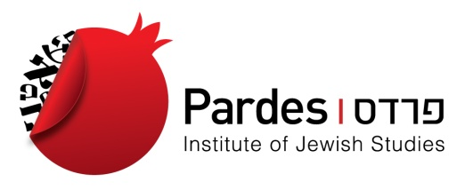
A state-in-the-making by 1939
Organizationally:
Grassroots Hibbat Zion movement
First Aliyah (1881)
World Zionist Organization founded by Theodor Herzl (1897)

Slide 3
A state-in-the-making by 1939
Aliyot:
5 waves of Jewish immigration, beg. 1881 in Russia, changed the face of the Yishuv
1881: 25,000 Jews in Palestine
1942: 400,000 (an increase of 16x in 60 years)
Very young, vibrant, idealistic community: in 1936, 85% under age of 45

Slide 4
A state-in-the-making by 1939
Jewish agriculture - hardly existed in 1881
1939: c.150 agricultural settlements,
a full ¼ of Jews living on land, w/ most successful agricultural communal life experiment in modern times: the kibbutz

Slide 5
A state-in-the-making by 1939
Jewish population in cities also grew tremendously:
Tel Aviv, founded in 1909, has 150,000 Jews in 1939;
Jerusalem, which had 16,000 Jews in 1881, had quintupled to 90,000;
Haifa, less than 1,000 Jews in 1881, now had 60,000

Slide 6
A state-in-the-making by 1939
Cultural Developments -
Revival of the Hebrew language:
Hebrew daily newspapers
Hebrew theatre
Universities teaching in Hebrew

Slide 7
A state-in-the-making by 1939
Military Developments:
Haganah
Etzel
Lechi

Slide 8
A state-in-the-making by 1939
Diplomatic Achievements:
1917: Balfour Declaration
1920: San Remo agreement
1922: League of Nations grants Britain Mandate over Palestine

