Slide 1

Key Vocabulary and Concepts for Unit 1
49/49 conversation
Intellectual humility
Intellectual curiosity
Mahloket le-shem shamayim
Mahloket lo le-shem shamayim
Elephant/rider
Moral foundations

Slide 2
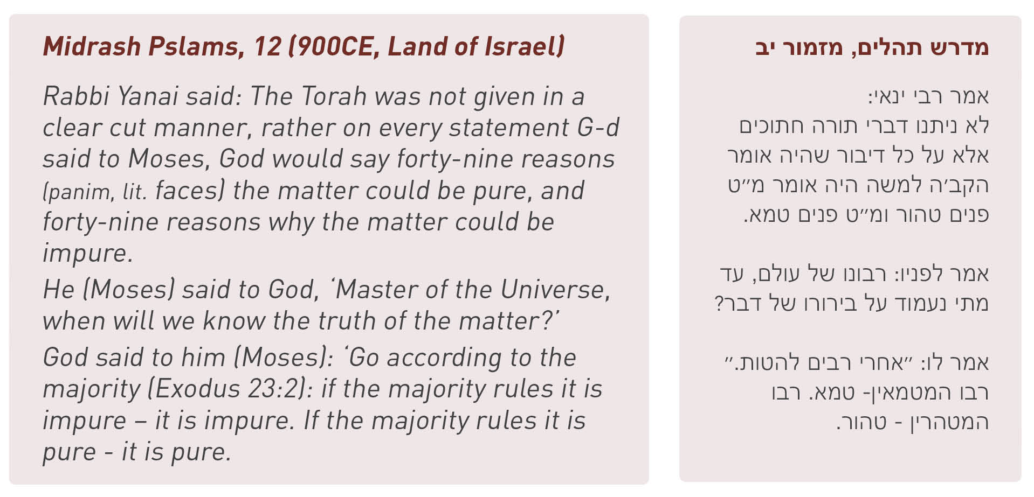

Slide 3



Slide 4


Slide 5
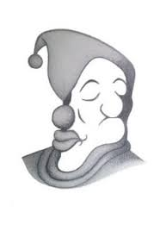

Slide 6
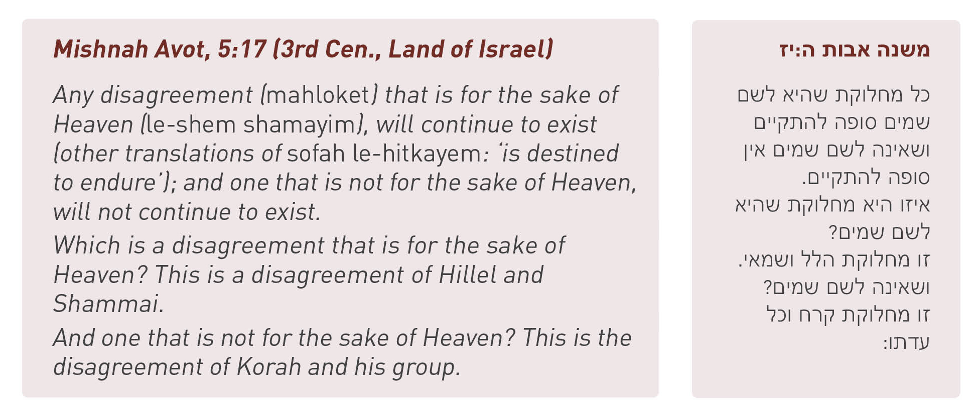
Text 2.1

Slide 7
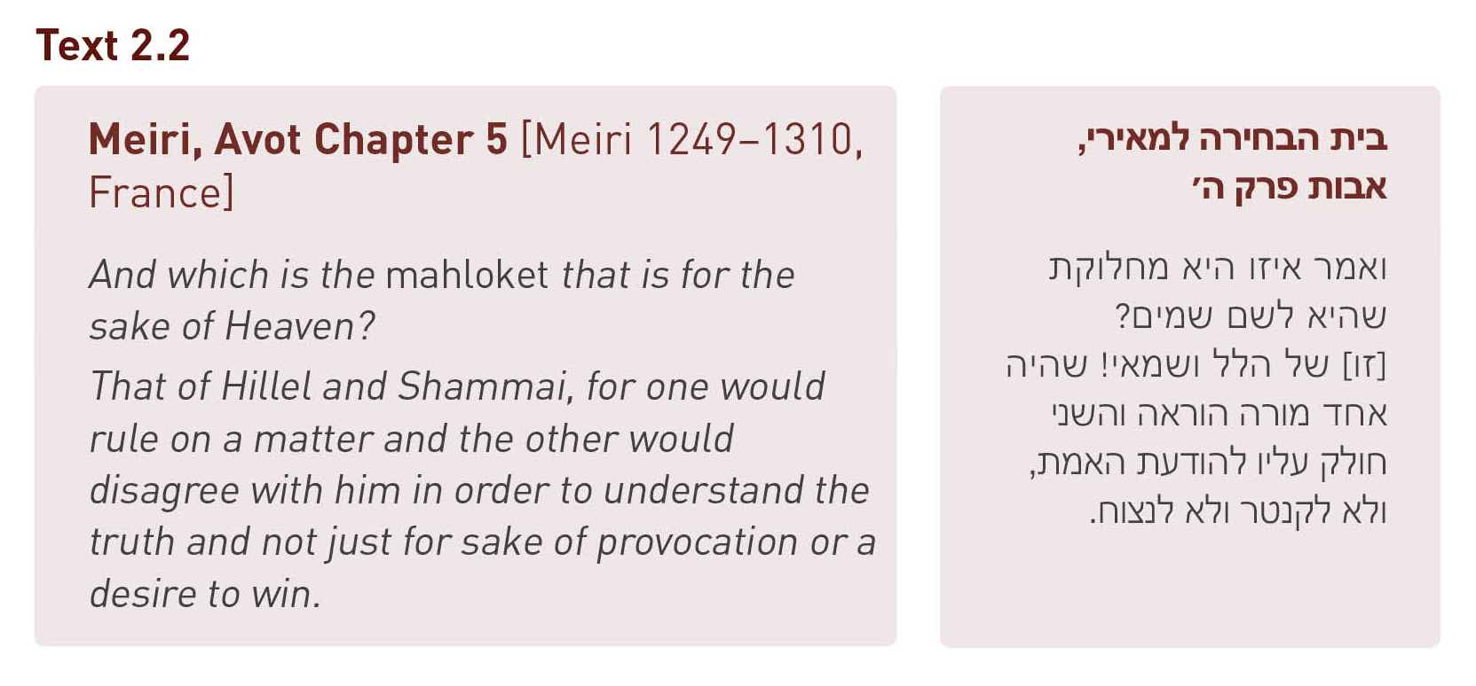

Slide 8
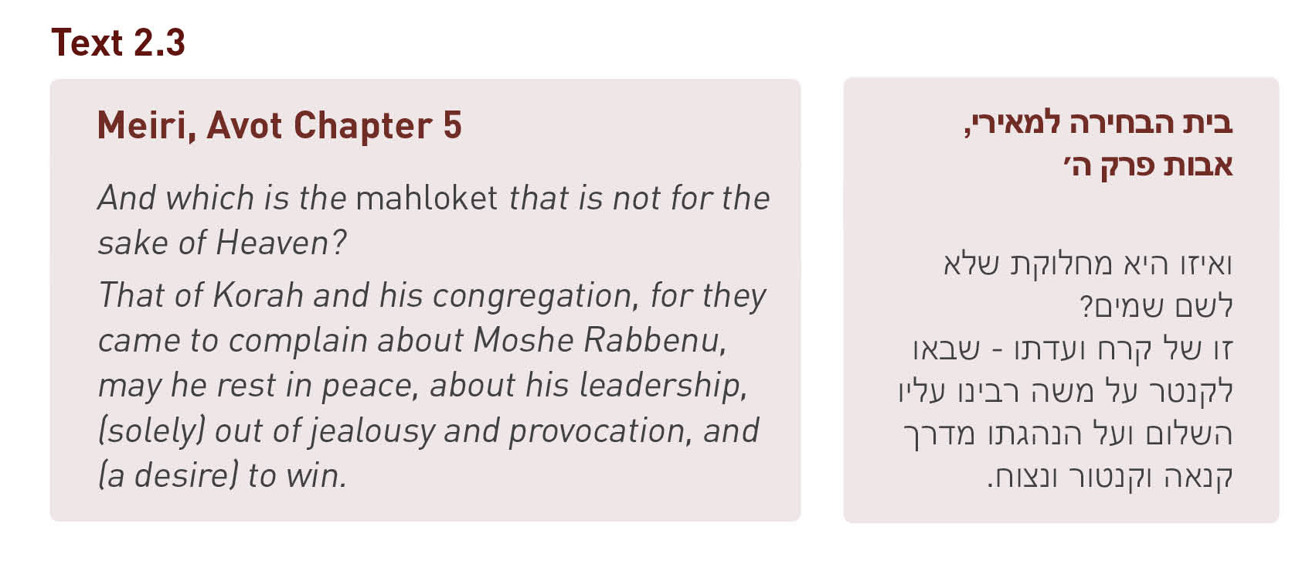

Slide 9



Slide 10

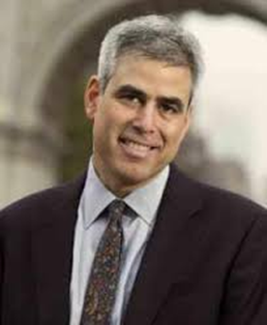
Jonathan Haidt
Social Psychologist

Slide 11
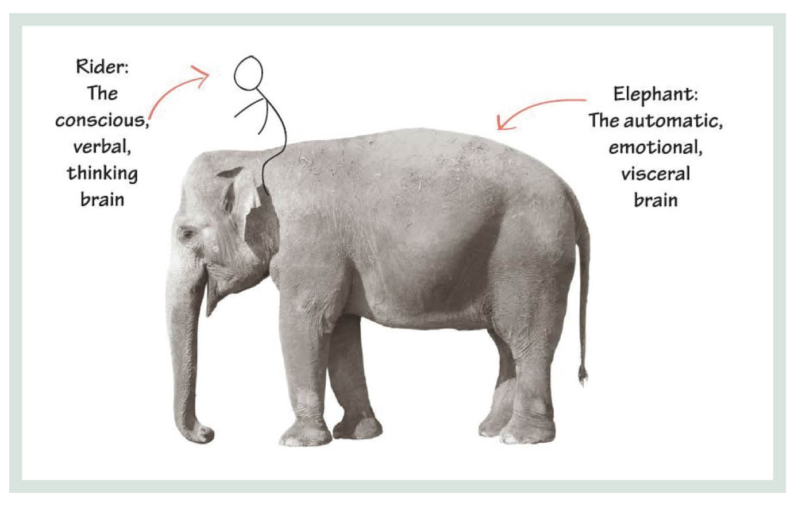
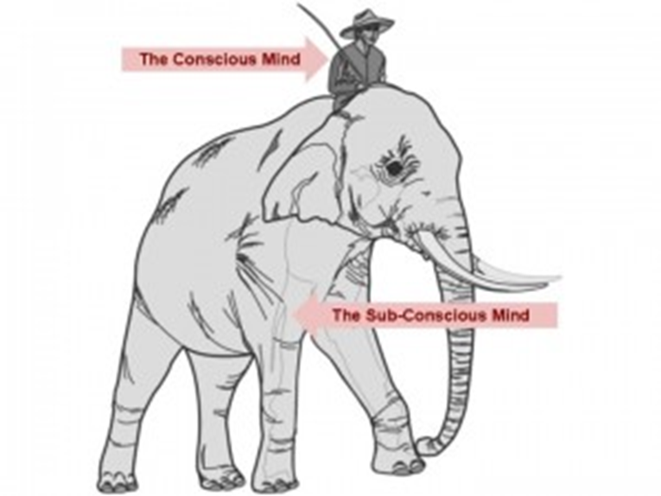

Slide 12
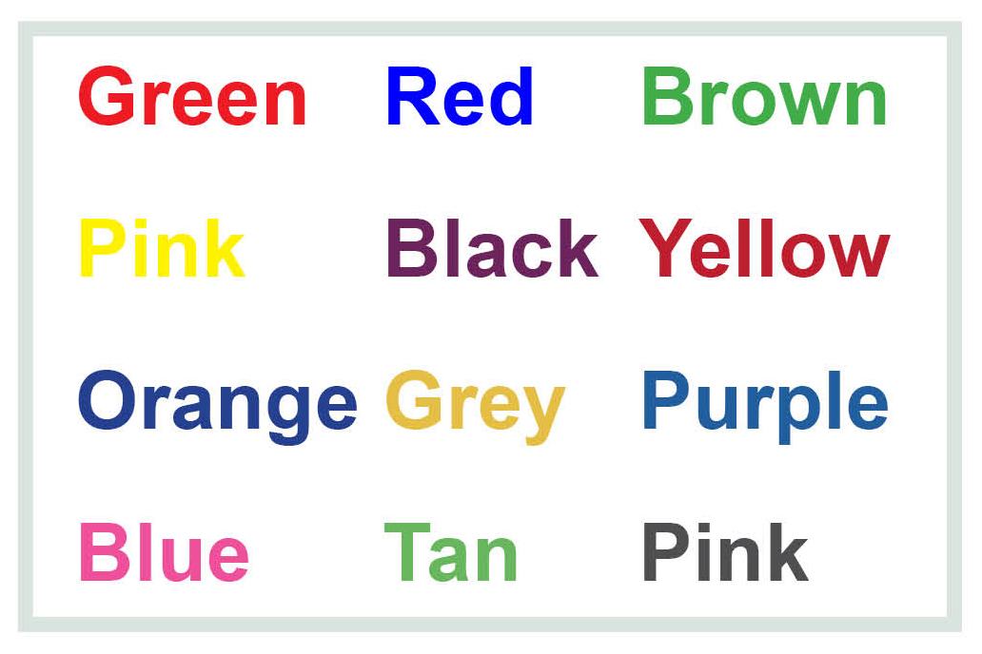
As quickly as possible, please read out loud the words below (from left to right).

Slide 13
This time, as quickly as possible, please say out loud the COLORS that you see.
Do NOT say the word that is written.
Instead, say the COLOR that you see (from left to right).
INSTRUCTIONS FOR ROUND #2:

Slide 15
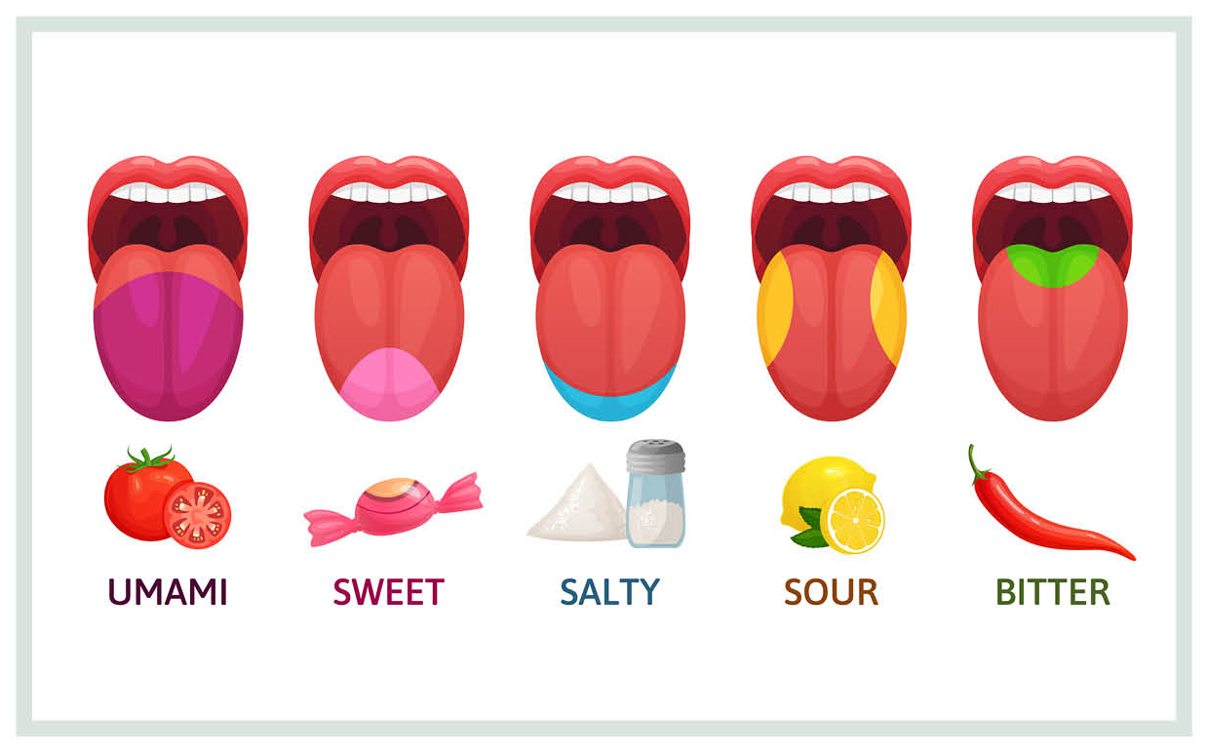

Slide 16
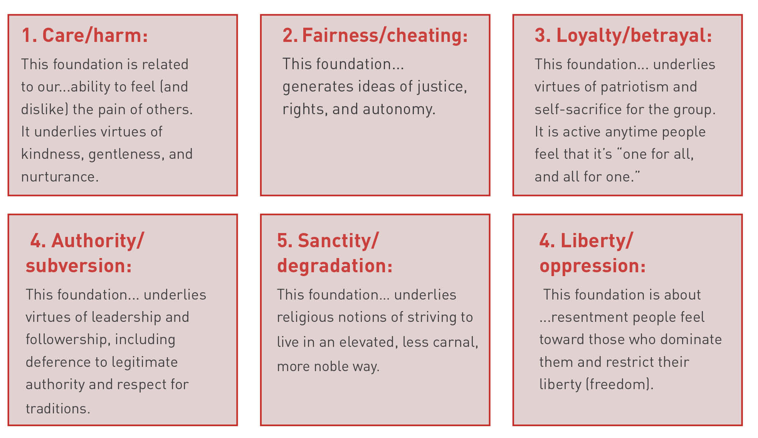

Slide 17
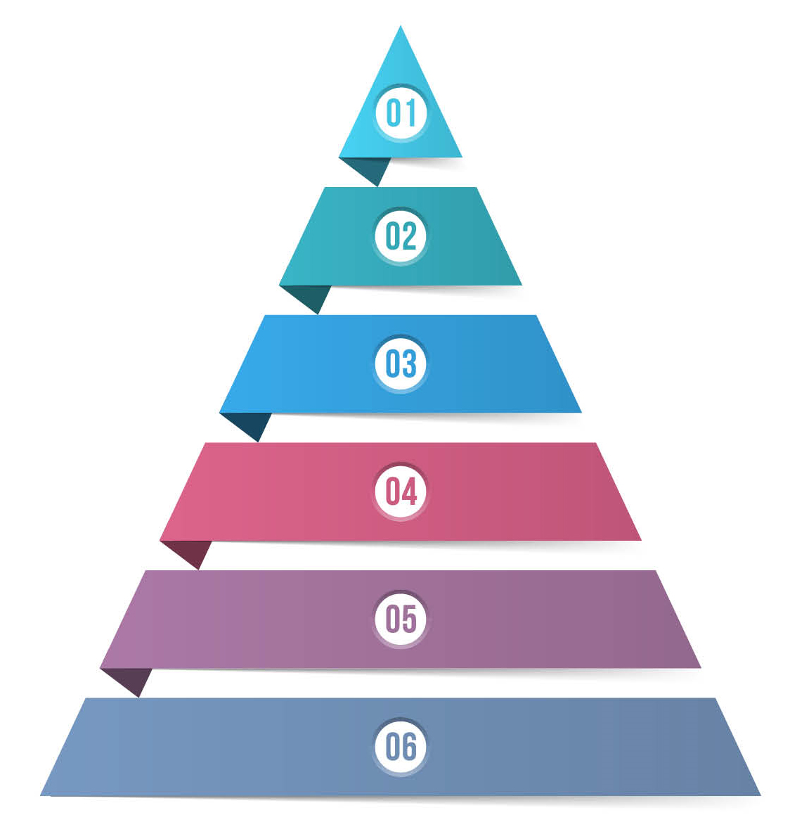
How would YOU prioritize the moral foundations?

Slide 18
If Donna’s state was considering revising its welfare policies, which view would Donna be more likely to take?
OPTION A
We should be more generous, especially to people raising children.
OPTION B
We should be more vigilant about cheaters who are “milking” the system.

Slide 19
Does Craig believe that it is appropriate to kneel during the US national anthem as a protest against racial inequality in America?
OPTION A
Yes
OPTION B
No

Slide 20
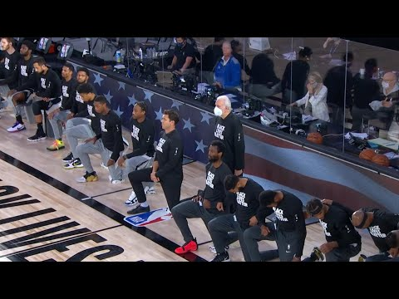

Slide 21
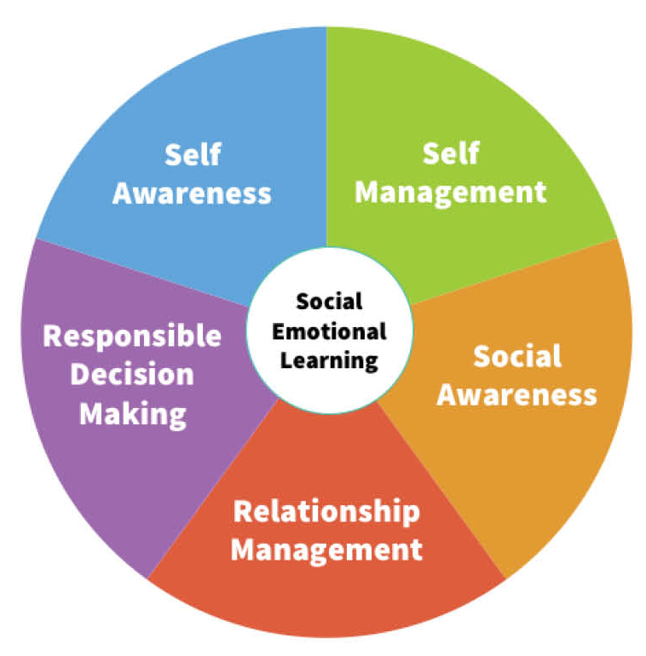
5 CORE
SOCIAL EMOTIONAL COMPETENCIES
(copied from CASEL)

