Slide 1
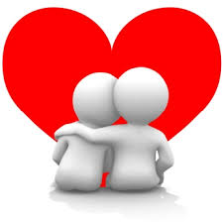
Let’s Talk About “IT”
The Eden Center - Pardes

Slide 2
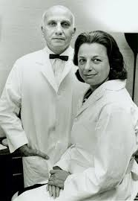
The Sexual Response Cycle Masters and Johnson

Slide 3
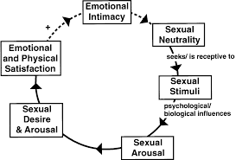
The Sexual Response Cycle – modified Rosemary Basson
Sexual and Non-Sexual

Slide 4
The evolution of the sexual response cycle
Willingness
Psychological and biological processing
Arousal and responsive sexual desire
Sexual satisfaction with or without orgasm
Non sexual “rewards”

Slide 5
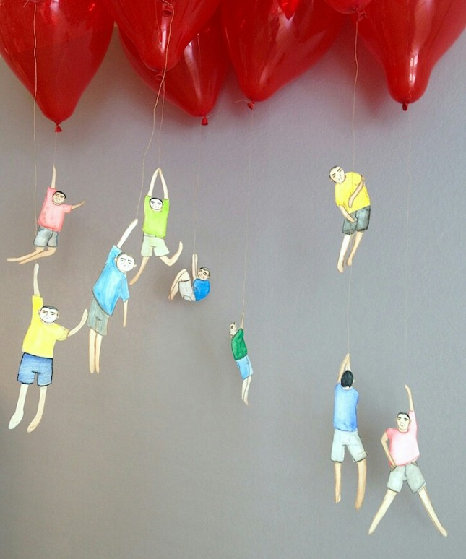
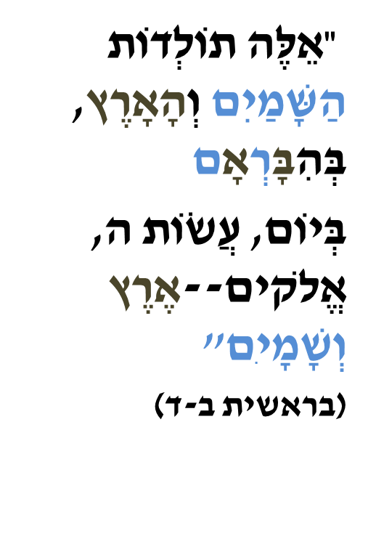
Emotional and Physical Satisfaction
“Romantics value intensity over stability.
Realists value security over passion.
But both are often disappointed, for few people can live happily et either extreme.” (Esther Perel, Mating in Captivity)

Slide 6
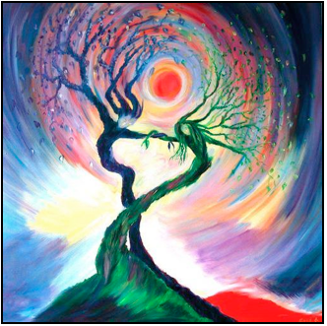
Resolving the Sexual Intimacy Paradox
Love enjoys knowing everything about you; desire needs mystery.
Love likes to shrink the distance that exists between me and you, while desire is energized by it. If intimacy grows through repetition and familiarity, eroticism is numbed by repetition. It thrives on the mysterious, the novel, and the unexpected. Love is about having; desire is about wanting. An expression of longing, desire requires ongoing elusiveness. It is less concerned with where it has already been than passionate about where it can still go. But too often, as couples settle into the comforts of love, they cease to fan the flame of desire. They forget that fire needs air.
Esther Perel; Mating in Captivity, 37

Slide 7
Identity Formation
Conflagration make love or war
Fusion
comfort/low desire
Merger
(power struggle)
Differentiation
Integration
Lobitz and Lobitz-1996

Slide 8
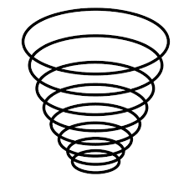
The Life Cycle
Spiral

